Slide 1
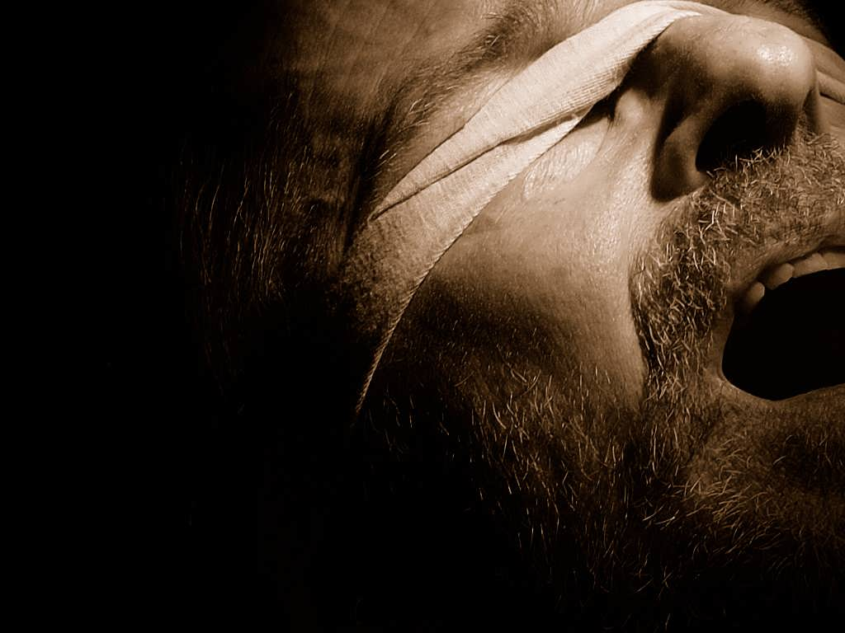
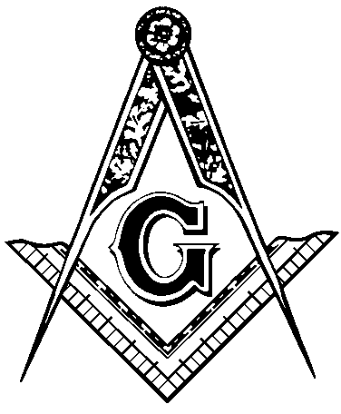


the bondage of
Cults and Isms
Freemasonry
A free CD of this message will be available following the service
It will also be available for podcast later this week at calvaryokc.com

Slide 2
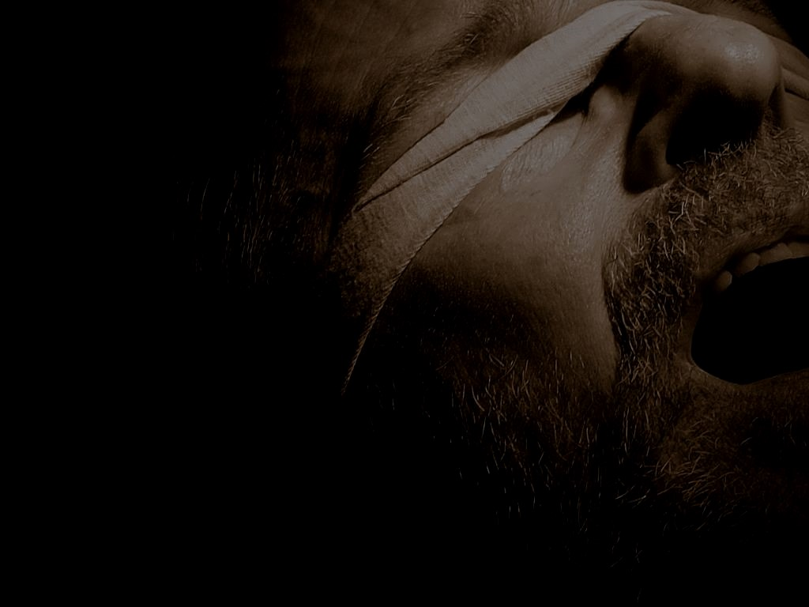
Ron Carlson ~ “Probably only 1 in 10,000 Masons fully understand what they are involved in.”
the bondage of Freemasonry

Slide 3
the bondage of Freemasonry

Slide 4
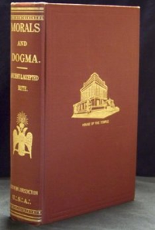
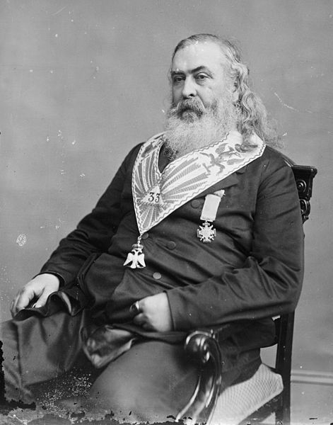
Morals and Dogma (1872)
Albert Pike (1809-1891)
the bondage of Freemasonry

Slide 5
the bondage of Freemasonry

Slide 6
1st three degrees ~ “Blue Degrees”
1. Entered Apprentice
2. Journeyman or Fellowcraft Member
3. Master Mason
the bondage of Freemasonry

Slide 7
the bondage of Freemasonry

Slide 8
1st three degrees ~ Oaths
“Binding myself under no less a penalty than having my throat cut across, my tongue torn out by its roots and buried in the rough sand of the sea.” (1st degree)
the bondage of Freemasonry

Slide 9
1st three degrees ~ Oaths
“Binding myself under no less a penalty than having my left breast torn open and my heart being plucked out and given to the prey of the beasts of the field and the fouls of the air.”
(2nd degree)
the bondage of Freemasonry

Slide 10
1st three degrees ~ Oaths
“Binding myself under no less a penalty than having my body severed in twain, my bowels taken from thence and burned in ashes and given to the beasts fields and the foals of the air.” (3rd degree)
the bondage of Freemasonry

Slide 11
the bondage of Freemasonry

Slide 12


Select Master
Royal Master
Order of Knights of Templar
Order of Knights of Malta
Order of the Red Cross
Super Excellent Master Council
Select Master
Royal Master
Royal Arch Mason
York
Rites
Most Excellent Master
Past Master
Mark Master
the bondage of Freemasonry

Slide 13
Select Master
Scottish Rites
the bondage of Freemasonry

Slide 14
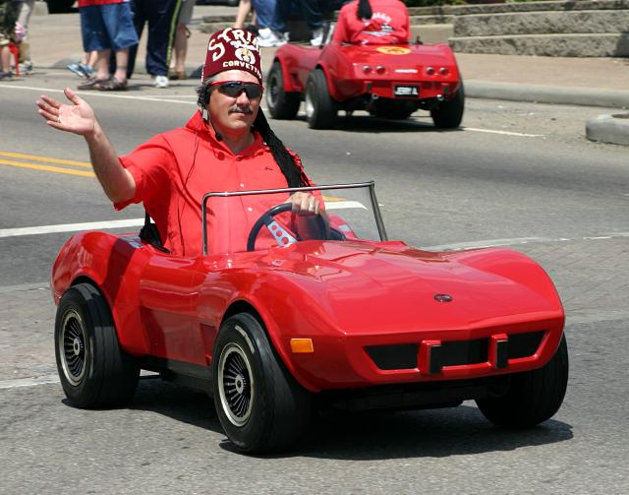
Select Master
A
NCIENT
A
RABIC
O
RDER OF THE
N
OBLES OF THE
M
YSTIC
S
HRINE
the bondage of Freemasonry

Slide 15
Well-known 33rd degree Freemasons
 | King Hussein | Tony Blair | James Cameron
 | Winston Churchill | Kenneth Copeland | Walt Disney
Newt Gingrich | Mikhail Gorbachev | Al Gore | Kenneth Hagin
J. Edgar Hoover |  | Bob Jones, Sr. | Henry Kissinger
Vladimir Lenin | Karl Marx |  | Shimon Peres
Colin Powell |  |  | F. D. Roosevelt
Al Sharpton | Joseph Stalin | Chaim Weizmann | H. G. Wells
Yasser Arafat
Jimmy Carter
Saddam Hsssein
B. B. Netanyahu
Yitzak Rabin
Ronald Reagan
the bondage of Freemasonry

Slide 16
the bondage of Freemasonry

Slide 17
Masonic Service Association of North America ~ “Freemasonry is not a religion, nor is it a substitute for religion. It requires of its members a belief in God as part of the obligation of every responsible adult, but advocates no sectarian faith or practice. Masonic ceremonies include prayers, both traditional and extempore, to reaffirm each individual's dependence on God
the bondage of Freemasonry

Slide 18
and to seek divine guidance. Freemasonry is open to men of any faith, but religion may not be discussed at Masonic meetings.”
the bondage of Freemasonry

Slide 19
M&D, pg. 213 ~ “Every Masonic Lodge is a Temple of Religion, and its teachings are instructions in Religion.”
the bondage of Freemasonry

Slide 20
Carl H. Claudy, Introduction to Freemasonry. p. 38 ~ “In his private petitions a man may petition God or Jehovah, Allah or Buddha, Mohammed or Jesus; he may call upon the God of Israel or the First Great Cause. In the Masonic Lodge he hears petition to the Great Architect of the Universe, finding his own deity under that name. A hundred paths may wind upward around a mountain; at the top they meet."
the bondage of Freemasonry

Slide 21
M&D, pg. 23 ~ “It [Freemasonry] reverences all the great reformers. It sees in Moses, the Lawgiver of the Jews, in Confucius and Zoroaster, in Jesus of Nazareth, and in the Arabian Iconoclast, Great Teachers of Morality, and Eminent Reformers, if no more; And allows every brother of the Order to assign to each such higher and even Divine Character as His creed and Truth require…”
the bondage of Freemasonry

Slide 22
M&D, pg. 744 ~ “The Bible, with all the allegories it contains, expresses, in an incomplete and veiled manner only, the religious science of the Hebrews."
the bondage of Freemasonry

Slide 23
M&D, pg. 224 ~ “The doctrines of the Bible are often not clothed in the language of strict truth, but in that which was fittest to convey to a rude and ignorant people the practical essentials of doctrine.”
the bondage of Freemasonry

Slide 24
the bondage of Freemasonry

Slide 25
M&D , pg. 226 ~ “(The Mason) considers that if there were no written revelation, he could safely rest the hopes that animate him and the principles that guide him, on the deductions of reason and the convictions of instinct and consciousness.”
the bondage of Freemasonry

Slide 26
The Generative Principle
The Universe
The Earth
the bondage of Freemasonry

Slide 27
the bondage of Freemasonry

Slide 28
M&D, pg. 567 ~ “To prevent the light from escaping at once the Demons forbade Adam to eat the fruit of 'Knowledge of good and evil,' by which he would have known the Empire of Light and that of Darkness. He obeyed; an Angel of Light induced him to transgress, and gave him the means of victory; but the Demons created Eve, who seduced him into an act of
the bondage of Freemasonry

Slide 29
Sensualism. That enfeebled him, and bound him anew in the bonds of matter. This is repeated in the case of every man that lives.”
the bondage of Freemasonry

Slide 30
the bondage of Freemasonry

Slide 31
Albert Pike, 1889 ~ “To you, Sovereign Grand Inspectors General, we say this, that you may repeat it to the Brethren of the 32nd, 31st, and 30th degrees - The Masonic Religion should be, by all of us initiates of the high degrees, maintained in the purity of the Luciferian Doctrine.
"If Lucifer were not God, would Adonay (The God of the Christians) whose deeds prove his cruelty, perfidy and hatred
the bondage of Freemasonry

Slide 32
of man, barbarism and repulsion for science, would Adonay and his priests, calumniate him?
“Yes, Lucifer is God, and unfortunately Adonay is also god. For the eternal law is that there is no light without shade, no beauty without ugliness, no white without black, for the absolute can only exist as two gods: darkness being necessary for light to serve as its foil
the bondage of Freemasonry

Slide 33
as the pedestal is necessary to the statue, and the brake to the locomotive.
“Thus, the doctrine of Satanism is a heresy; and the true and pure philosophical religion is the belief in Lucifer, the equal of Adonay; but Lucifer, God of Light and God of Good, is struggling for humanity against Adonay, the God of Darkness and Evil."
the bondage of Freemasonry

Slide 34
Encyclopedia of Freemasonry, pg. 618 ~ “Freemasonry is not Christianity …”
the bondage of Freemasonry

Slide 35
the bondage of Freemasonry

Slide 36
Freemasonry Growth Chart
4,000,000
3,500,000
3,000,000
2,500,000
2,000,000
1,500,000
1,000,000
1920
1930
1940
1950
1960
1970
1980
1990
2000
2010
the bondage of Freemasonry

Slide 37
(From 1991 report) 37% Southern Baptists are Freemasons
14% SBC pastors
18% SBC deacon board members
the bondage of Freemasonry

Slide 38
the bondage of Freemasonry

Slide 39
M&D, pp. 104-105 ~ “Masonry, like all religions, all the Mysteries, … conceals its secrets from all except the Adepts and Sages, or the Elect, and uses false explanations and misinterpretations of its symbols to mislead those who deserve only to be misled; to conceal the Truth, which it calls Light, from them, and to draw them away from it. Truth is not for those who are unworthy or unable to receive it, or would pervert it.”
the bondage of Freemasonry

Slide 40
M&D, pg. 819 ~ “The Blue Degrees are but the outer or portico of the Temple. Part of the symbols are displayed there to the Initiate, but he is intentionally misled by false interpretations. It is not intended that he shall understand them, but it is intended that he shall imagine he understands them.“
the bondage of Freemasonry

Slide 41
the bondage of Freemasonry

Slide 42
Edmund Ronayne, Handbook of Masonry, pg. 183 ~ “You must conceal all crimes of your brother Masons...and should you be summoned as a witness against a brother Mason be always sure to shield him...It may be perjury to do this, it is true, but you're keeping your obligations."
the bondage of Freemasonry

Slide 43
the bondage of Freemasonry

